Slide 1
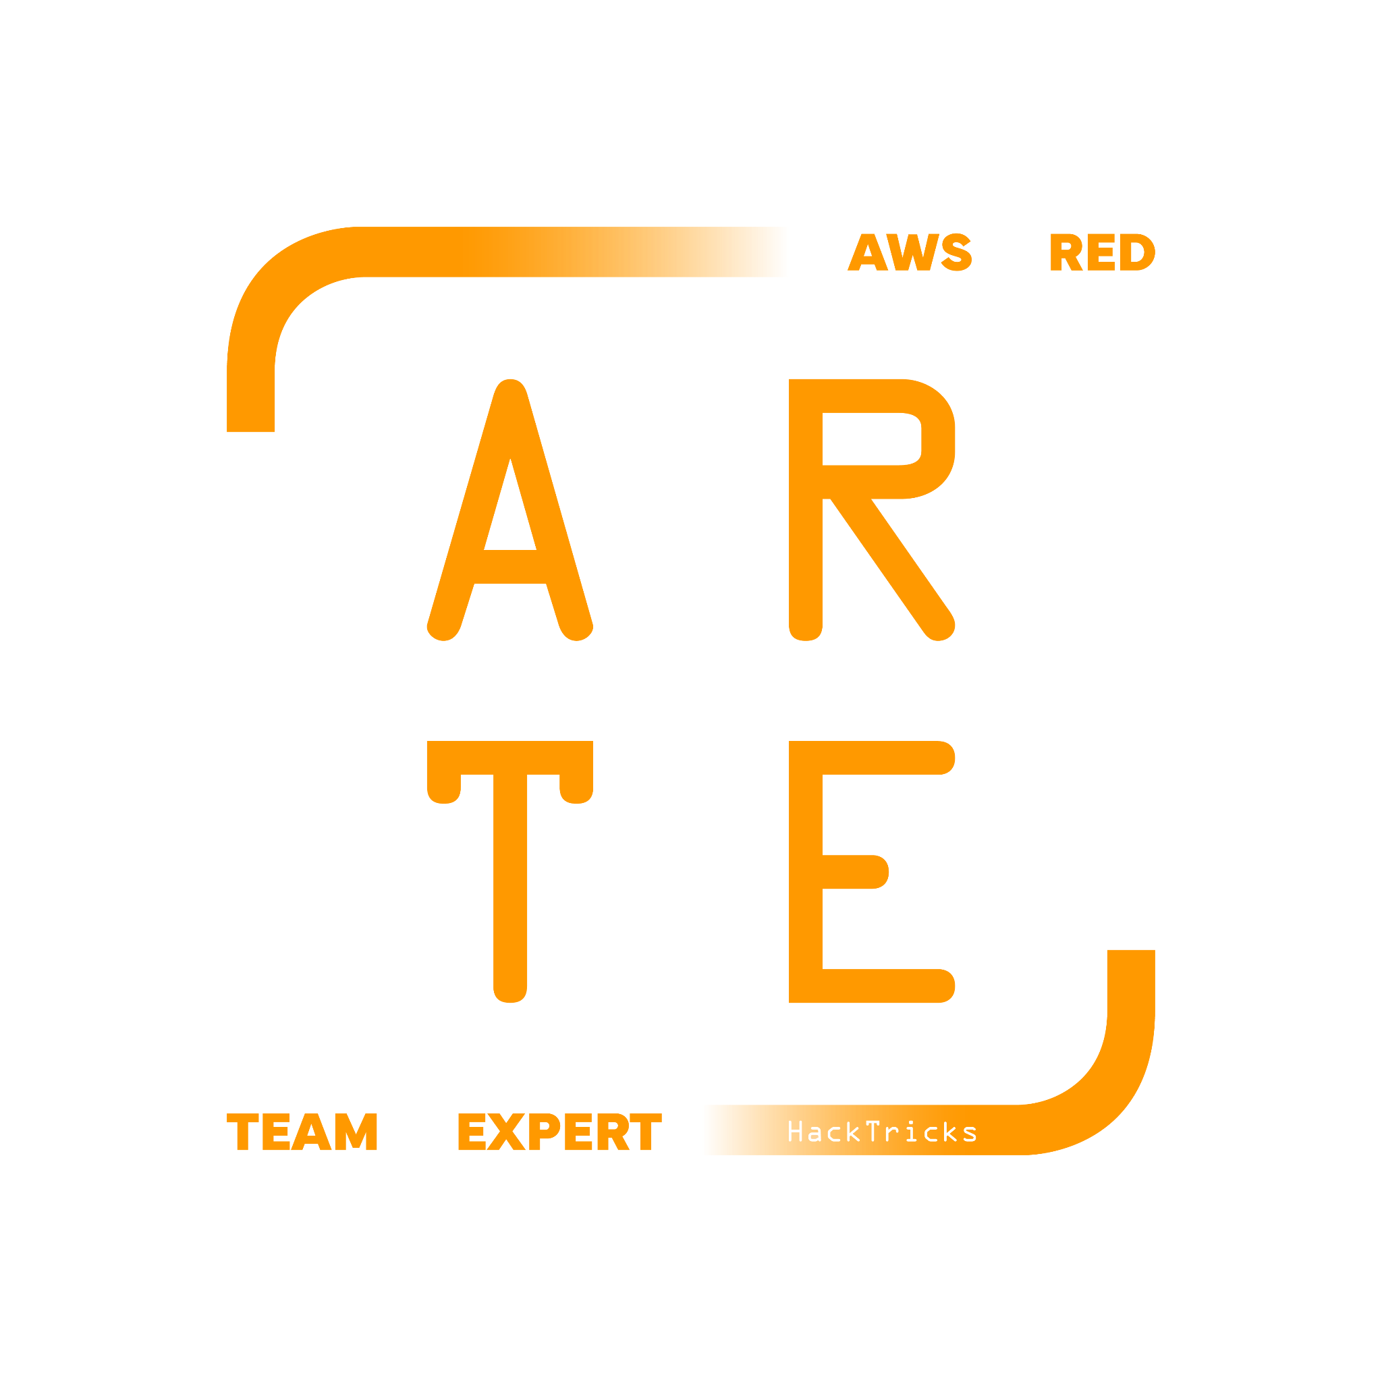
EC2
Elastic Cloud Computing
HackTricks Training
https://t.me/CyberFreeCourses

Slide 2
Basic Information
VPC - Virtual Private Cloud
Subnets
Route Tables
Internet Gateways
ACLs
Security Groups
Elastic IP Addresses
VPNs
EC2
Instance / AMI / Volume / Snapshot
Instance Profiles
Metadata
SSM
ELB
https://t.me/CyberFreeCourses

Slide 3
VPC - Virtual Private Cloud
Virtual Private Clouds (VPCs) are a fundamental component of Amazon Web Services (AWS) infrastructure that provides customers with a logically isolated section of the AWS Cloud to launch their AWS resources in. The main concepts of Amazon VPC include:
Subnets: VPCs are divided into subnets, which are smaller network segments that can be used to isolate AWS resources for security or performance reasons.
Route Tables: Route tables determine the traffic routing for a subnet within a VPC. They determine which network traffic is forwarded to the internet or to a VPN connection.
Network Access Control Lists (ACLs): Network ACLs are firewall rules that control incoming and outgoing network traffic to a subnet. They can be used to allow or deny traffic to specific IP addresses or ranges.
Internet Gateway: An Internet Gateway is a VPC component that allows communication between instances in your VPC and the internet.
Security Groups: Security groups are a virtual firewall that control inbound and outbound network traffic to instances in a VPC.
Elastic IP addresses: Elastic IP addresses are static IP addresses assigned to an AWS account. They can be associated with an EC2 instance, which allows the IP address to persist even if the instance is stopped or restarted.
Virtual Private Network (VPN): VPNs allow you to securely connect your on-premises network to your VPC over the internet.
https://t.me/CyberFreeCourses
https://cloud.hacktricks.xyz/pentesting-cloud/aws-pentesting/aws-services/aws-ec2-ebs-elb-ssm-vpc-and-vpn-enum/aws-vpc-and-networking-basic-information

Slide 4
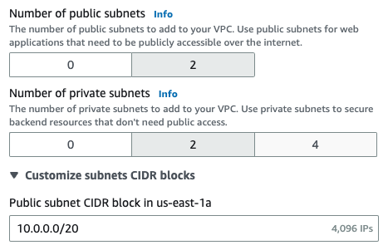
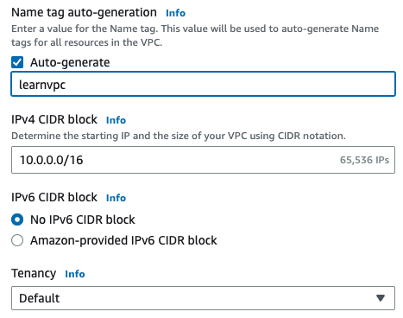
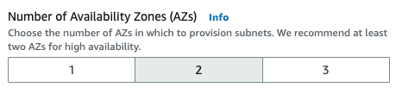
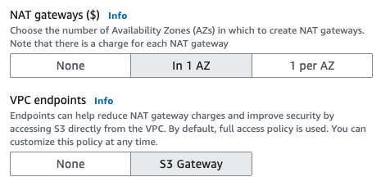
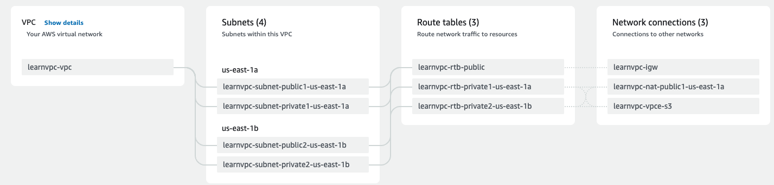
VPC - Virtual Private Cloud
https://t.me/CyberFreeCourses
https://cloud.hacktricks.xyz/pentesting-cloud/aws-pentesting/aws-services/aws-ec2-ebs-elb-ssm-vpc-and-vpn-enum/aws-vpc-and-networking-basic-information

Slide 5
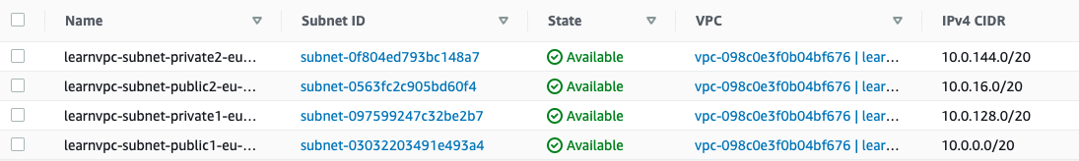
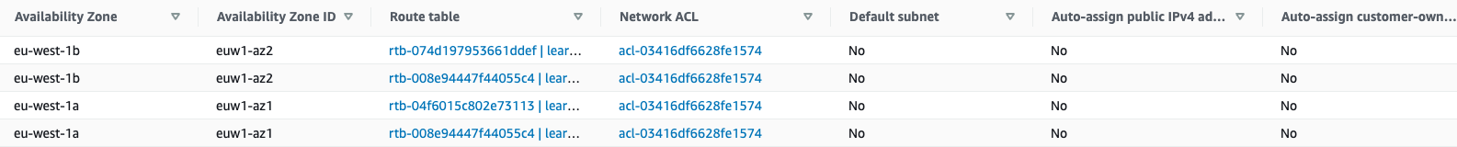
VPC - Subnets
Subnets: VPCs are divided into subnets, which are smaller network segments that can be used to isolate AWS resources for security or performance reasons.
When creating resources that need to be allocated in some network you will need to choose subnetworks, not VPCs.
https://t.me/CyberFreeCourses
https://cloud.hacktricks.xyz/pentesting-cloud/aws-pentesting/aws-services/aws-ec2-ebs-elb-ssm-vpc-and-vpn-enum/aws-vpc-and-networking-basic-information

Slide 6
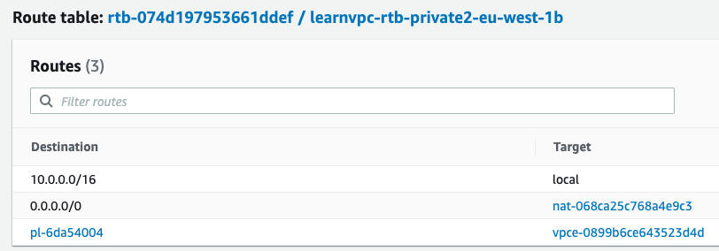
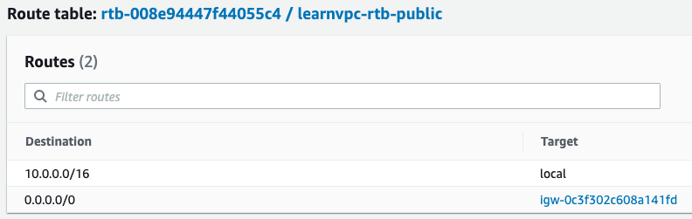
VPC - Route Tables
Route Tables: Route tables determine the traffic routing for a subnet within a VPC. They determine which network traffic is forwarded to the internet or to a VPN connection.
In general, nobody touches these values. You will usually find access to the:
Local VPC
NAT
Internet Gateways / Egress-only Internet gateways (needed to give a VPC access to the Internet).
VPC endpoints (to access S3 from private networks)
https://t.me/CyberFreeCourses
https://cloud.hacktricks.xyz/pentesting-cloud/aws-pentesting/aws-services/aws-ec2-ebs-elb-ssm-vpc-and-vpn-enum/aws-vpc-and-networking-basic-information

Slide 7
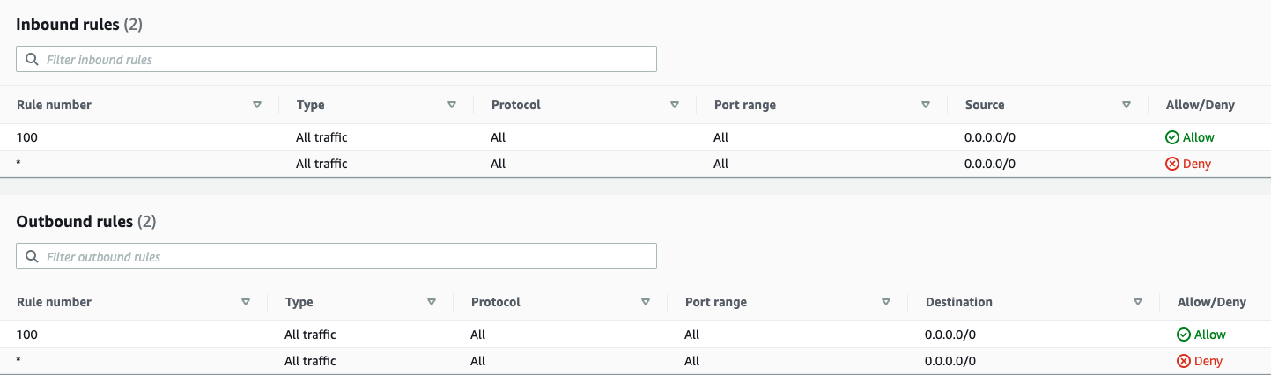
VPC - ACLs
Network Access Control Lists (ACLs): Network ACLs are firewall rules that control incoming and outgoing network traffic to a subnet. They can be used to allow or deny traffic to specific IP addresses or ranges.
It’s most frequent to allow/deny access using security groups, but this is the way to completely cut established reverse shells (from EC2 to outside). A modified rule in a security groups doesn’t stop already established connections
However, this applies to the whole subnetworks so needed functionality might be disturbed
https://t.me/CyberFreeCourses
https://cloud.hacktricks.xyz/pentesting-cloud/aws-pentesting/aws-services/aws-ec2-ebs-elb-ssm-vpc-and-vpn-enum/aws-vpc-and-networking-basic-information

Slide 8
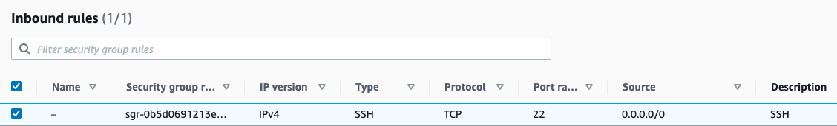
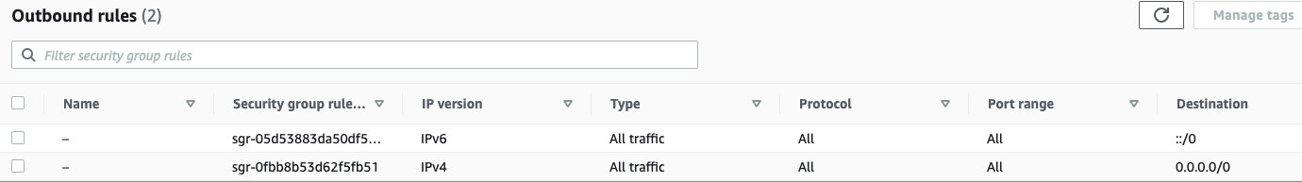
VPC - Security Groups
Security Groups: Security groups are a virtual firewall that control inbound and outbound network traffic to instances in a VPC.
Relation M to M instances (usually 1 to 1).
https://t.me/CyberFreeCourses
https://cloud.hacktricks.xyz/pentesting-cloud/aws-pentesting/aws-services/aws-ec2-ebs-elb-ssm-vpc-and-vpn-enum/aws-vpc-and-networking-basic-information

Slide 9
EC2 - Instances/Volumes/AMIs/Snapshots
Instance: This is the working virtual machine
Volume: A disk containing information. An instance need to have at least 1 volume but it can have more.
AMI: An Amazon Machine Image (AMI) is a pre-configured virtual machine image, used to create an instance in the Amazon Web Services (AWS) Elastic Compute Cloud (EC2).
You can generate an AMI from an Instance
Snapshot: An Amazon Elastic Compute Cloud (EC2) Snapshot is a point-in-time copy of an Amazon Elastic Block Store (EBS) volume. A snapshot is a useful tool for backing up data stored on an EBS volume, and for migrating data between EC2 instances or between AWS regions.
Main differences between an AMI and a Snapshot: an AMI is used to launch an EC2 instance, while an EC2 Snapshot is used to back up and recover data stored on an EBS volume. While an EC2 Snapshot can be used to create a new AMI, it is not the same thing as an AMI, and it does not include information about the operating system, application server, or other software required to run an application.
https://t.me/CyberFreeCourses
https://cloud.hacktricks.xyz/pentesting-cloud/aws-pentesting/aws-services/aws-ec2-ebs-elb-ssm-vpc-and-vpn-enum#ebs

Slide 10
EC2 - Instance Profiles
AWS instance profiles are a feature of the Amazon Web Services (AWS) platform that provides a way to grant access to AWS resources from an EC2 instance. Instance profiles are associated with an IAM role, which defines the permissions to access AWS resources.
Instance profiles are needed because they allow EC2 instances to access AWS resources without the need for long-term access keys. Instead, the instance is assigned a role, and temporary credentials are generated for the role to access AWS resources. This reduces the risk of leaked credentials and helps to ensure that the principle of least privilege is followed, since the instance can only access the resources that are specified in the associated IAM role.
For example, an EC2 instance might need to access an S3 bucket to retrieve data or write logs, or it might need to access an RDS database to retrieve data or write records. The instance profile makes it possible to grant these permissions to the EC2 instance in a secure and manageable way, without the need to store long-term credentials on the instance.
https://t.me/CyberFreeCourses
https://cloud.hacktricks.xyz/pentesting-cloud/aws-pentesting/aws-services/aws-ec2-ebs-elb-ssm-vpc-and-vpn-enum#ebs

Slide 11
EC2 - Metadata
AWS EC2 metadata is information about an Amazon Elastic Compute Cloud (EC2) instance that is available to the instance at runtime. This metadata is used to provide information about the instance, such as its instance ID, the availability zone it is running in, the IAM role associated with the instance, and the instance's hostname.
Accessible in http://169.254.169.254.
There are 2 versions, the second version requires obtaining a token using the PUT verb to contact metadata endpoints and obtain information.
UPDATE: Note that if the EC2 instance is enforcing IMDSv2, according to the docs, the response of the PUT request will have a hop limit of 1, making impossible to access the EC2 metadata from a container inside the EC2 instance.
Moreover, IMDSv2 will also block requests to fetch a token that include the X-Forwarded-For header. This is to prevent misconfigured reverse proxies from being able to access it.
For complete information about which info you can obtain from the metadata endpoint check https://book.hacktricks.xyz/pentesting-web/ssrf-server-side-request-forgery/cloud-ssrf
https://t.me/CyberFreeCourses
Notes:
Run instance (Amazon Linux so it has SSM installed) and login via SSH.
Then use hacktricks to contact the metadata instance and learn how to do that
Then run: curl -L https://github.com/carlospolop/PEASS-ng/releases/latest/download/linpeas.sh | sh

Slide 12
EC2 - SSM
Amazon Simple Systems Manager (SSM) allows to remotely manage floats of EC2 instances to make their administrations much easier. Each of these instances need to be running the SSM Agent service, as the service will be the one getting the actions and performing them from the AWS API.
SSM Agent makes it possible for Systems Manager to update, manage, and configure these resources. The agent processes requests from the Systems Manager service in the AWS Cloud, and then runs them as specified in the request.
The SSM Agent comes preinstalled in some AMIs or you need to manually install them on the instances. Also, the IAM Role used inside the instance needs to have the policy AmazonEC2RoleforSSM attached to be able to communicate.
https://t.me/CyberFreeCourses
https://cloud.hacktricks.xyz/pentesting-cloud/aws-pentesting/aws-services/aws-ec2-ebs-elb-ssm-vpc-and-vpn-enum#ssm
Notes:
Interact with SSM of the created instance
aws ssm describe-instance-information
aws ssm start-session --target "$INSTANCE_ID"
ps aux | grep amazon-ssm

Slide 13
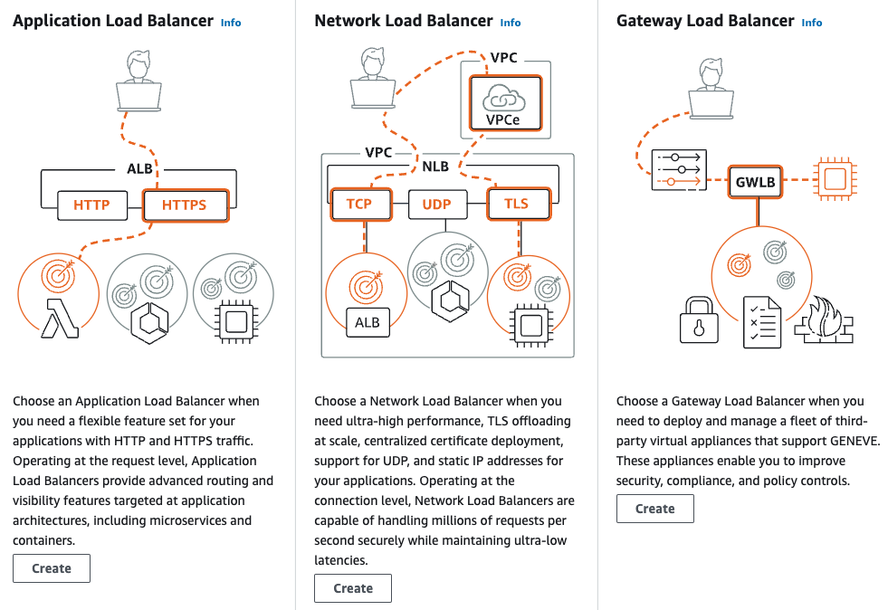
EC2 - ELB - Elastic Load Balancer
Elastic Load Balancing (ELB) is a load-balancing service for Amazon Web Services (AWS) deployments. ELB automatically distributes incoming application traffic and scales resources to meet traffic demands.
https://t.me/CyberFreeCourses
https://cloud.hacktricks.xyz/pentesting-cloud/aws-pentesting/aws-services/aws-ec2-ebs-elb-ssm-vpc-and-vpn-enum#ebs

Slide 14
EC2 - Manual Enumeration
# Get EC2 instances
aws ec2 describe-instances
aws ec2 describe-instance-status #Get status from running instances
# Get user data from each ec2 instance
for instanceid in $(aws ec2 describe-instances | grep -Eo '"i-[a-zA-Z0-9]+' | tr -d '"'); do
aws ec2 describe-instance-attribute --instance-id "$instanceid" --attribute userData
done
# Instance profiles
aws iam list-instance-profiles
aws iam list-instance-profiles-for-role --role-name <name>
# Get SSH Key Pairs
aws ec2 describe-key-pairs
# Get VPCs
aws ec2 describe-vpcs
aws ec2 describe-vpc-peering-connections
# Get subnetworks
aws ec2 describe-subnets
# Get security groups
aws ec2 describe-security-groups
# Get FW rules
aws ec2 describe-network-acls
# SSM
aws ssm describe-instance-information
aws ssm describe-parameters
# ELBs
aws elb describe-load-balancers
aws elbv2 describe-load-balancers
https://t.me/CyberFreeCourses
https://cloud.hacktricks.xyz/pentesting-cloud/aws-pentesting/aws-services/aws-ec2-ebs-elb-ssm-vpc-and-vpn-enum#ebs

Slide 15
EC2 - Unauthenticated Access
Open ports
Vulnerabilities
SSRF
Public AMIs
aws ec2 describe-images --executable-users all
Public EBS Snapshots
aws ec2 describe-snapshots --restorable-by-user-ids all
For more information check https://cloud.hacktricks.xyz/pentesting-cloud/aws-pentesting/aws-unauthenticated-enum-access/aws-ec2-unauthenticated-enum
https://t.me/CyberFreeCourses
Notes:
List public AMIs & EBS snapshots

Slide 16
EC2 - Privilege Escalation
There are tens of different ways to escalate privileges exploiting EC2 & related permissions. There are ways to even escalate privileges locally in an instance.
EC2 permissions:
iam:PassRole, ec2:RunInstances
Privesc to ECS
ec2:ModifyInstanceAttribute
ec2-instance-connect:SendSSHPublicKey
EBS permissions:
ebs:ListSnapshotBlocks, ebs:GetSnapshotBlock, ec2:DescribeSnapshots
SSM permissions:
ssm:SendCommand
ssm:ListCommands
ssm:StartSession
Privesc to ECS
For more information check https://cloud.hacktricks.xyz/pentesting-cloud/aws-pentesting/aws-privilege-escalation/aws-ec2-privesc
https://t.me/CyberFreeCourses

Slide 17
EC2 - Post Exploitation
Instances and the network are places where a lot of sensitive information is usually stored, processed and sent. Any action that allows you to access this data would be a post exploitation technique:
Malicious VPC Mirror
Steal data from running instance or snapshots
SSM requests steal
Privesc to ECS
For more information check https://cloud.hacktricks.xyz/pentesting-cloud/aws-pentesting/aws-post-exploitation/aws-ec2-ebs-ssm-and-vpc-post-exploitation
https://t.me/CyberFreeCourses

Slide 18
EC2 - Persistence
Anyway, to keep access to the IAM roles, instances or network would be a persistence technique:
Security Group Connection Tracking Persistence
EC2 Lifecycle Manager
Backdoor Instances
VPN / VPC Peering
For more information check https://cloud.hacktricks.xyz/pentesting-cloud/aws-pentesting/aws-persistence/aws-ec2-persistence
https://t.me/CyberFreeCourses
Notes:
Get a rev shell from the instance and a ssh connection and change the SG to disallow all ingress and egress

